Slide 1
Atopic Dermatitis (Eczema)
2/23/21
Tyler Jones

Slide 2
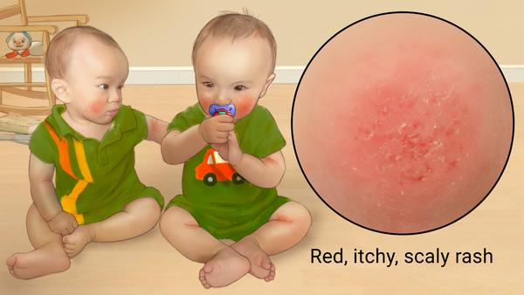
Introduction to Atopic Dermatitis

Slide 3
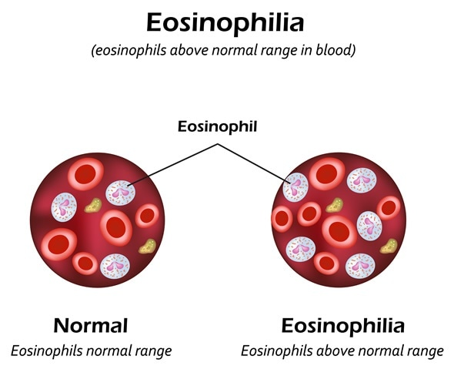
Relation to Autoimmune diseases
Eosinophil counts:
Normal ~ 113.3 eosinophils/μL
AD ~ 290.0 eosinophils / μL

Slide 4
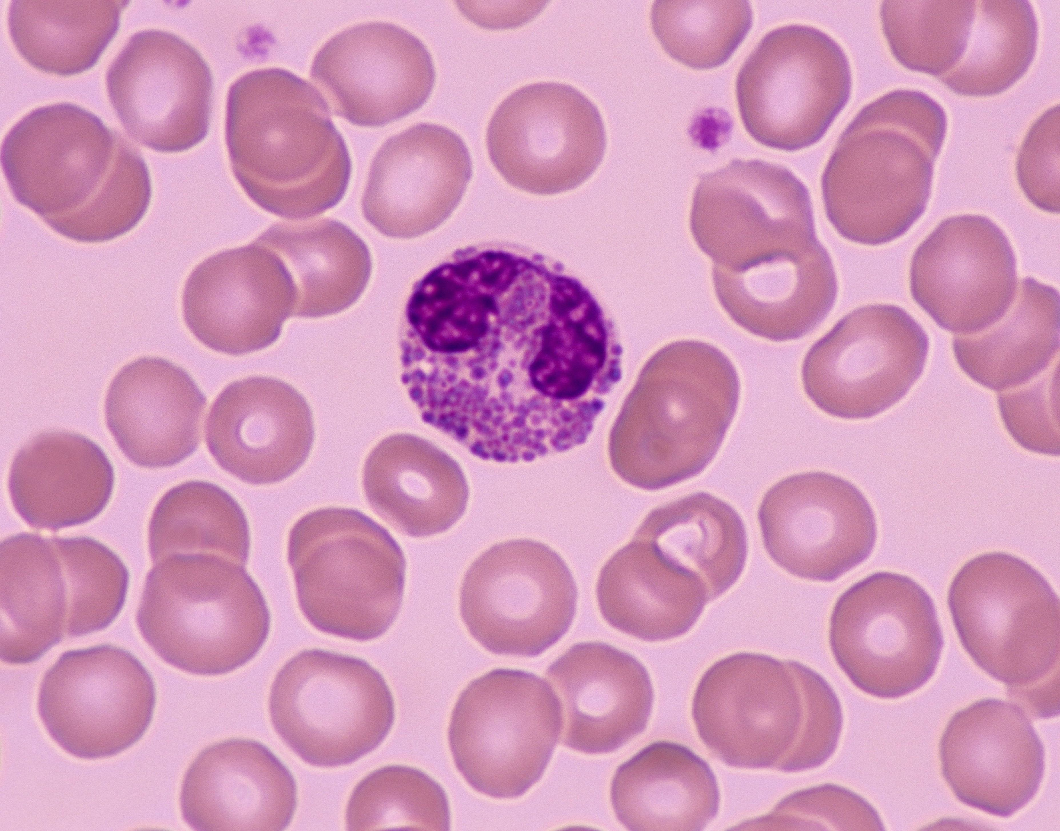
Eosinophils
White Blood Cells
Associated with allergic reaction
Can lead to inflammation and tissue damage

Slide 5
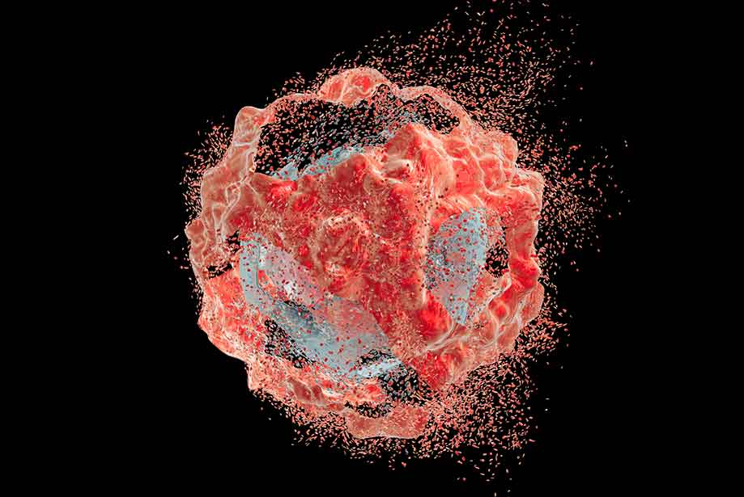
Fas associated factor family member 2 FAF2

Slide 6
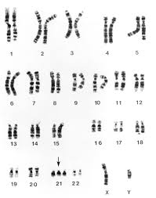
FAF2
Highly Expressed in those with atopic dermatitis
(176448328, 176510074)

Slide 7
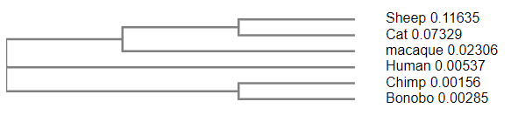
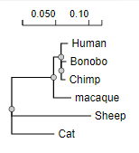
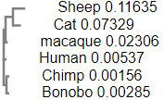
Multiple Sequence Alignment
Mammals found with sequences similar to this gene

Slide 8
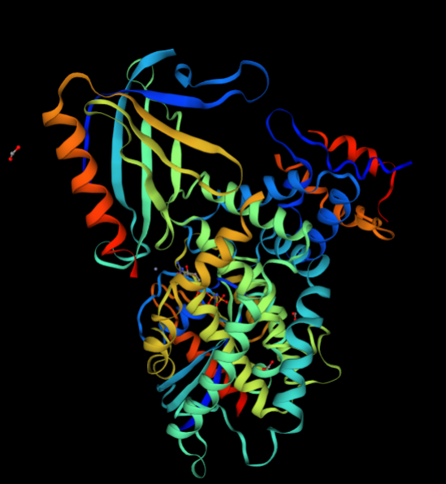
Conserved Domains
UBA and UBX Domains
Down Regulation Neurofibromin 1

Slide 9
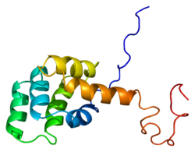
FAF1 and FAF2
FAF1 related to FAS receptor
FAF2 Not fully understood

Slide 10
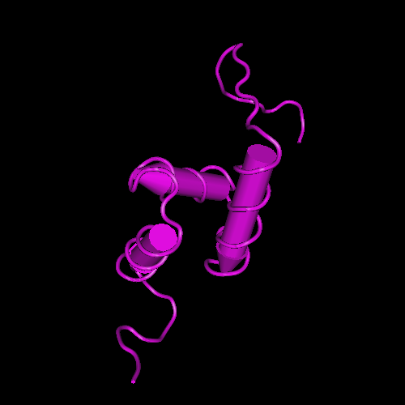
UBX domain containing 8, isoform / ETEA

Slide 11
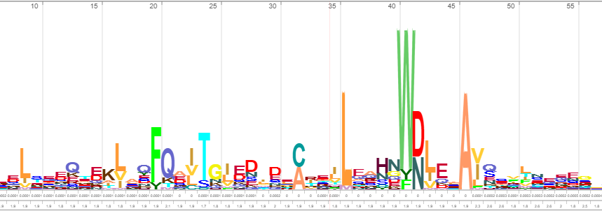
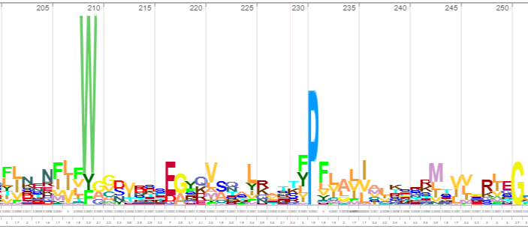
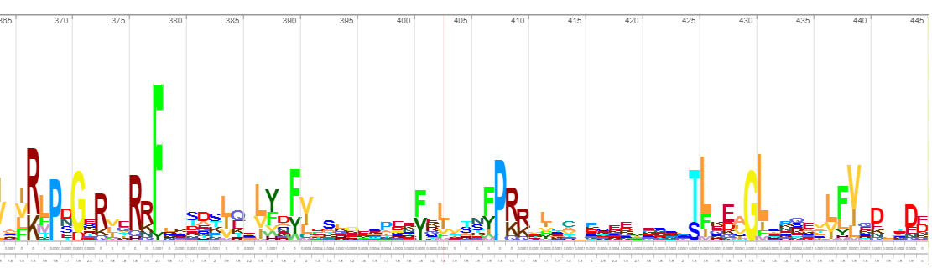
Conserved Domains

Slide 12
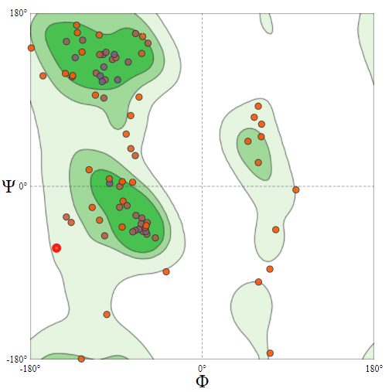
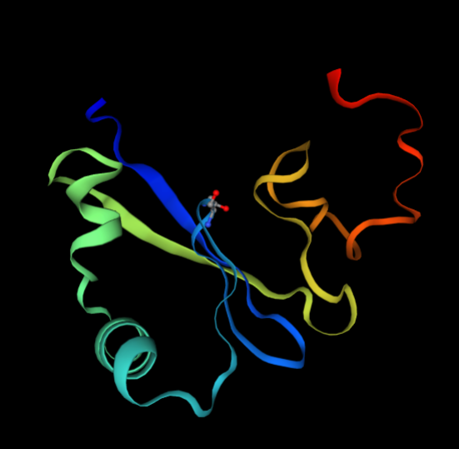
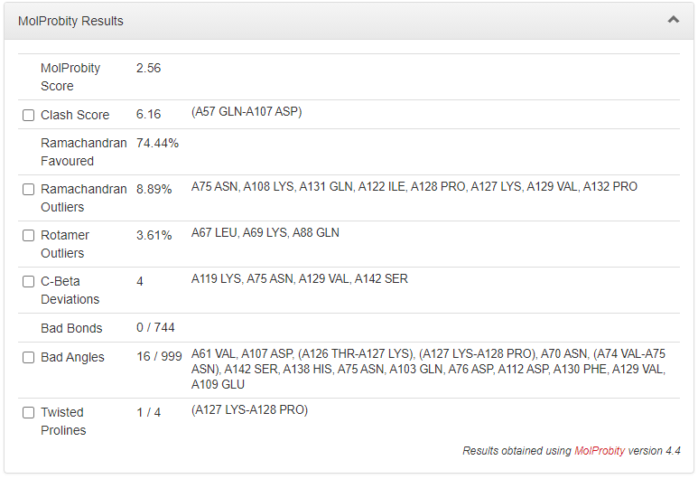
UBX model

Slide 13
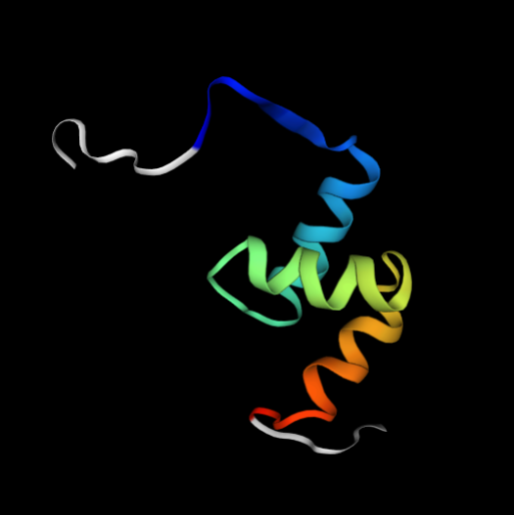
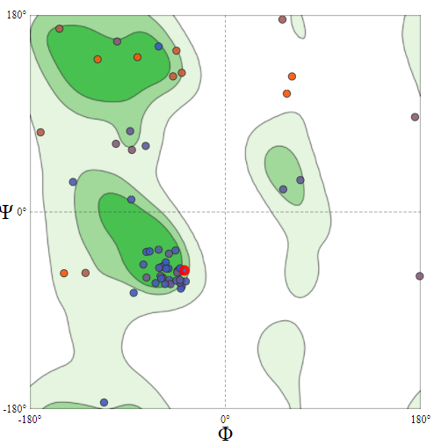
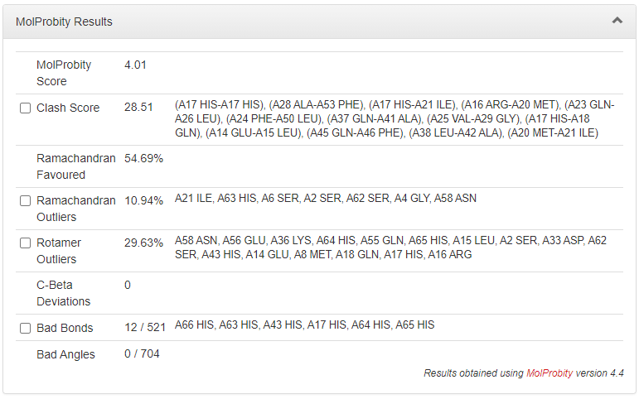
UBA model

Slide 14
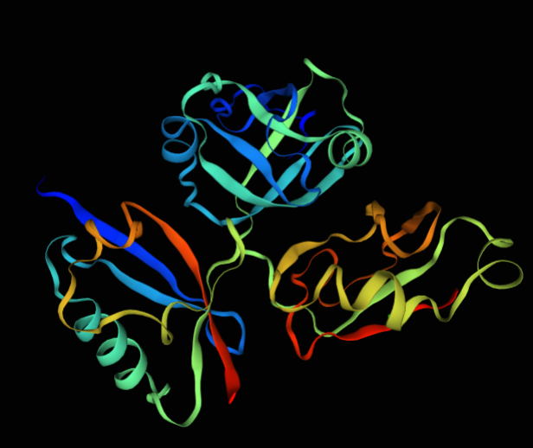
Comparison to FAF1
FAF1
UBA
UBX
FAF2

Slide 15
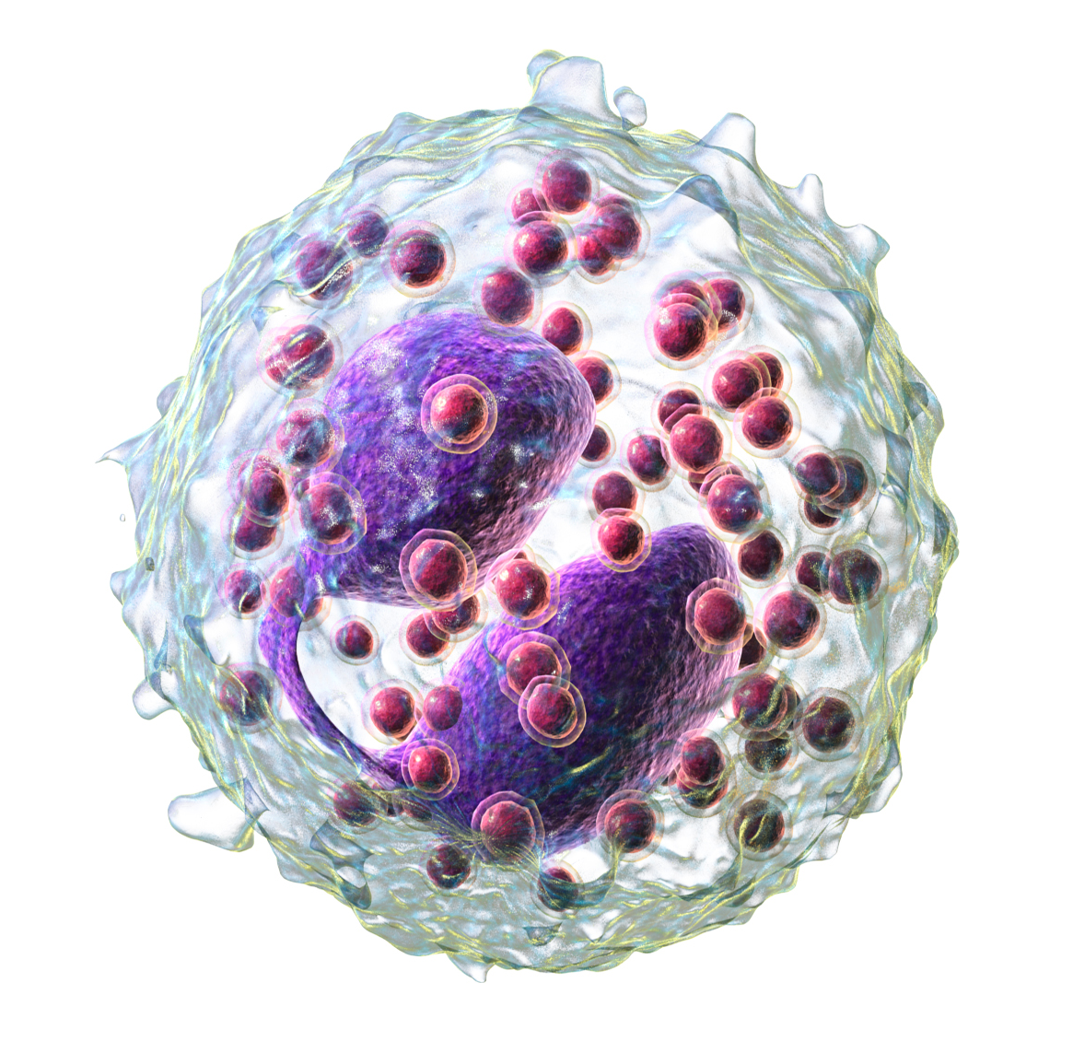
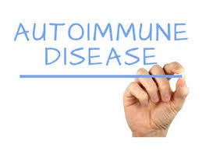
Possible Future Exploration

Slide 16
Bibliography
Imai, Y., Nakada, A., Hashida, R., Sugita, Y., Tanaka, T., Tsujimoto, G., Matsumoto, K., Akasawa, A., Saito, H., & Oshida, T. (2002). Cloning and characterization of the highly expressed ETEA gene from blood cells of atopic dermatitis patients. Biochemical and biophysical research communications, 297(5), 1282–1290.
Jenerowicz, D., Czarnecka-Operacz, M., & Silny, W. (2007). Peripheral blood eosinophilia in atopic dermatitis. Acta dermatovenerologica Alpina, Pannonica, et Adriatica, 16(2), 47–52.
Menges, C. W., Altomare, D. A., & Testa, J. R. (2009). FAS-associated factor 1 (FAF1): diverse functions and implications for oncogenesis. Cell cycle (Georgetown, Tex.), 8(16), 2528–2534. https://doi.org/10.4161/cc.8.16.9280
Phan, V. T., Ding, V. W., Li, F., Chalkley, R. J., Burlingame, A., & McCormick, F. (2010). The RasGAP proteins Ira2 and neurofibromin are negatively regulated by Gpb1 in yeast and ETEA in humans. Molecular and cellular biology, 30(9), 2264–2279.
Su, V., & Lau, A. F. (2009). Ubiquitin-like and ubiquitin-associated domain proteins: significance in proteasomal degradation. Cellular and molecular life sciences : CMLS, 66(17), 2819–2833. https://doi.org/10.1007/s00018-009-0048-9

